Slide 1
The Bible Class 2

Slide 2
The Bible – Class 2
Genesis
The Book of Origins. The origin of the universe, the human race, etc. Largely a record of the early history of the chosen people.
Who wrote the book; many believe it to be Moses
Why was this book written; Tells how God created the universe and human beings. It also cover special promises God made to Abraham, Isaac and Jacob.
What do we learn about God in this book: God created all things. He loves people, but he will punish sin. God promises to save people who trust him.
Who are the key people in this book; Adam, Eve, Noah, Abraham and Sarah, Isaac and Rebekah, Jacob and Rachel, and Joseph.
Where did this happen; Genesis 1-11 happened in Mesopotamia. Genesis 12-36 took place in Canaan, which is also called the promised land. The rest of Genesis took place in Egypt.

Slide 3
The Bible – Class 2
The creation story does not give us a scientific textbook but a story of God’s creative working. “All these things have their origin in a single power, God’s eternal Reason, experienced in the creative power of the Word.” ^{Pg 18} (Ratzinger, 2022)
Outline of Genesis
Preamble. The Creation of the World (1:1–2:3)
I. The Story of the Nations (2:4–11:26)
The Creation of the Man and the Woman, Their Offspring, and the Spread of Civilization (2:4–4:26)
The Pre-flood Generations (5:1–6:8)
The Flood and the Renewed Blessing (6:9–9:29)
The Populating of the World and the Prideful City (10:1–11:9)
The Genealogy from Shem to Terah (11:10–26)
II. The Story of the Ancestors of Israel (11:27–50:26)
The Story of Abraham and Sarah (11:27–25:18)
The Story of Isaac and Jacob (25:19–36:43)
The Story of Joseph (37:1–50:26)
Reference: Genesis, THE BOOK OF GENESIS | USCCB

Slide 4
The Bible – Class 2
The creation story does not give us a scientific textbook but a story of God’s creative working. “All these things have their origin in a single power, God’s eternal Reason, experienced in the creative power of the Word.” ^{Pg 18} (Ratzinger, 2022)
Stories
God creates the universe: Genesis 1
God creates Adam and Eve: Genesis 2
Adam and Eve Sin: Genesis 3
Noah builds an ark: Genesis 6
God sends a flood to punish sin: Genesis 7-8
God gives promises to Abraham: Genesis 12
Abraham prays for a city: Genesis 18
Jacob steals Esau’s blessing: Genesis 27
Jacob’s name is changed: Genesis 32
Joseph’s brothers sell him into slavery: Genesis 37
Joseph becomes a ruler: Genesis 39-41

Slide 5
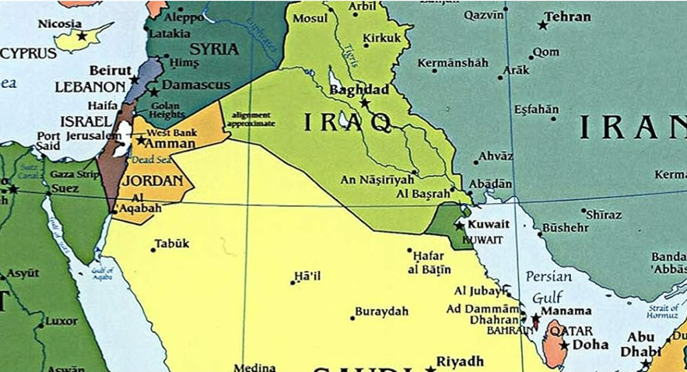
The Bible – Class 2

Slide 6
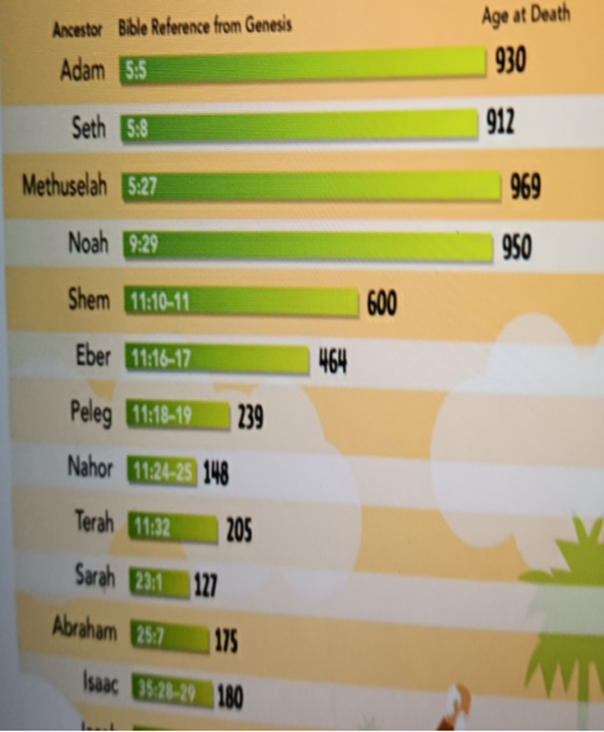
The Bible – Class 2

Slide 7
The Bible – Class 2
How can we understand a biblical text; not coming up with ideas of our own but remaining honest with ourselves and the interpreters of history – and yet , without doing violence to the text, inquire into its relevance for the present?
Text: Genesis 1:1-8
The Beginning ¹In the beginning God created the heavens and the earth. ²Now the earth was formless and empty, darkness was over the surface of the deep, and the Spirit of God was hovering over the waters. ³And God said, “Let there be light,” and there was light. ⁴God saw that the light was good, and he separated the light from the darkness. ⁵God called the light “day,” and the darkness he called “night.” And there was evening, and there was morning—the first day. Parallel Days ⁶And God said, “Let there be a vault between the waters to separate water from water.” ⁷So God made the vault and separated the water under the vault from the water above it. And it was so. ⁸God called the vault “sky.” And there was evening, and there was morning—the second day. (Zondervan, 2016)

Slide 8
The Bible – Class 2
“We know how it goes from there; over the course of seven days one element after another, then living things. Then finally on the sixth day, man is created and on the seventh day God rests”. (Ratzinger, 2022)
How did the ancient church and the current church deal with the dichotomy between what we know of science and what is described here in the Biblical text?
“The answer, which gradually became the common point of view in the field of Catholic theology starting in the 1930’s, is based on the idea of literary genre. This view says the Bible is not a scientific textbook, nor does it claim to be; it is a religious book, which means it cannot be used to acquire scientific information or to learn how the world came to be as far as the natural processes involved are concerned”. (Ratzinger, 2022)
“According to this view, Scripture is not trying to tell us how the different kinds of plants came about, how the sun and the moon and the stars were formed, but it is ultimately using this imagery to say only one thing: God created the world. All these things have their origin in a single power, God’s eternal Reason, experienced in the creative power of the Word”. (Ratzinger, 2022) pg18

Slide 9
The Bible – Class 2
Adam and Eve
Genesis 2 ⁴This is the account of the heavens and the earth when they were created, when the LORD God made the earth and the heavens. ⁵Now no shrub had yet appeared on the earth and no plant had yet sprung up, for the LORD God had not sent rain on the earth and there was no one to work the ground, ⁶but streams came up from the earth and watered the whole surface of the ground. ⁷Then the LORD God formed a man from the dust of the ground and breathed into his nostrils the breath of life, and the man became a living being. ⁸Now the LORD God had planted a garden in the east, in Eden; and there he put the man he had formed. ⁹The LORD God made all kinds of trees grow out of the ground—trees that were pleasing to the eye and good for food. In the middle of the garden were the tree of life and the tree of the knowledge of good and evil. ¹⁰A river watering the garden flowed from Eden; from there it was separated into four headwaters. ¹¹The name of the first is the Pishon; it winds through the entire land of Havilah, where there is gold. ¹²(The gold of that land is good; aromatic resin and onyx are also there.)

Slide 10
The Bible – Class 2
¹³The name of the second river is the Gihon; it winds through the entire land of Cush. ¹⁴The name of the third river is the Tigris; it runs along the east side of Ashur. And the fourth river is the Euphrates. ¹⁵The LORD God took the man and put him in the Garden of Eden to work it and take care of it. ¹⁶And the LORD God commanded the man, “You are free to eat from any tree in the garden; ¹⁷but you must not eat from the tree of the knowledge of good and evil, for when you eat from it you will certainly die.” ¹⁸The LORD God said, “It is not good for the man to be alone. I will make a helper suitable for him.” ¹⁹Now the LORD God had formed out of the ground all the wild animals and all the birds in the sky. He brought them to the man to see what he would name them; and whatever the man called each living creature, that was its name. ²⁰So the man gave names to all the livestock, the birds in the sky and all the wild animals. But for Adam no suitable helper was found.

Slide 11
The Bible – Class 2
²¹So the Lord God cast a deep sleep on the man, and while he was asleep, he took out one of his ribs and closed up its place with flesh. ²²The Lord God then built the rib that he had taken from the man into a woman. When he brought her to the man, ²³the man said: “This one, at last, is bone of my bones and flesh of my flesh; This one shall be called ‘woman,’ for out of man this one has been taken.” ²⁴ That is why a man leaves his father and mother and clings to his wife, and the two of them become one body. ²⁵The man and his wife were both naked, yet they felt no shame.
Donald Senior; John Collins; Mary Ann Getty. The Catholic Study Bible (p. 1465). Oxford University Press. Kindle Edition.

Slide 12
The Bible – Class 2
Genesis 3 The Fall
¹Now the snake was the most cunning of all the wild animals that the Lord God had made. He asked the woman, “Did God really say, ‘You shall not eat from any of the trees in the garden’?” ²The woman answered the snake: “We may eat of the fruit of the trees in the garden; ³ it is only about the fruit of the tree in the middle of the garden that God said, ‘You shall not eat it or even touch it, or else you will die.’ ” ⁴But the snake said to the woman: “You certainly will not die! ⁵God knows well that when you eat of it your eyes will be opened and you will be like gods, who know good and evil.” ⁶The woman saw that the tree was good for food and pleasing to the eyes, and the tree was desirable for gaining wisdom. So she took some of its fruit and ate it; and she also gave some to her husband, who was with her, and he ate it. ⁷Then the eyes of both of them were opened, and they knew that they were naked; so they sewed fig leaves together and made loincloths for themselves.
Donald Senior; John Collins; Mary Ann Getty. The Catholic Study Bible (p. 1465). Oxford University Press. Kindle Edition

Slide 13
The Bible – Class 2
⁸When they heard the sound of the Lord God walking about in the garden at the breezy time of the day, the man and his wife hid themselves from the Lord God among the trees of the garden. ⁹The Lord God then called to the man and asked him: Where are you? ¹⁰He answered, “I heard you in the garden; but I was afraid, because I was naked, so I hid.” ¹¹Then God asked: Who told you that you were naked? Have you eaten from the tree of which I had forbidden you to eat? ¹²The man replied, “The woman whom you put here with me— she gave me fruit from the tree, so I ate it.” ¹³The Lord God then asked the woman: What is this you have done? The woman answered, “The snake tricked me, so I ate it.” ¹⁴Then the Lord God said to the snake: Because you have done this, cursed are you among all the animals, tame or wild; On your belly you shall crawl, and dust you shall eat all the days of your life. ¹⁵I will put enmity between you and the and between your offspring and hers; They will strike at your head, while you strike at their heel. ¹⁶To the woman he said: I will intensify your toil in childbearing; in pain you shall bring forth children. Yet your urge shall be for your husband, and he shall rule over you. ¹⁷To the man he said: Because you listened to your wife and ate from the tree about which I commanded you, You shall not eat from it, Cursed is the ground because of you!

Slide 14
The Bible – Class 2
In toil you shall eat its yield all the days of your life. ¹⁸Thorns and thistles it shall bear for you, and you shall eat the grass of the field. ¹⁹By the sweat of your brow you shall eat bread, Until you return to the ground, from which you were taken; For you are dust, and to dust you shall return. ²⁰The man gave his wife the name “Eve,” because she was the mother of all the living. ²¹The Lord God made for the man and his wife garments of skin, with which he clothed them. ²²Then the Lord God said: See! The man has become like one of us, knowing good and evil! Now, what if he also reaches out his hand to take fruit from the tree of life, and eats of it and lives forever? ²³The Lord God therefore banished him from the garden of Eden, to till the ground from which he had been taken. ²⁴He expelled the man, stationing the cherubim and the fiery revolving sword east of the garden of Eden, to guard the way to the tree of life.
Donald Senior; John Collins; Mary Ann Getty. The Catholic Study Bible (p. 1467). Oxford University Press. Kindle Edition.

Slide 15
The Bible – Class 2
Noah builds an ark: Genesis 6
The Pre-Flood home of Noah and his family was in the area of Babylonia which was some 500 miles east from Mount Ararat, in what is today modern Turkey. After the flood they migrated back to their homeland and built cities. God then caused the confusion of languages which caused them to disperse into the world.
Genesis 6: ⁵The LORD saw how great the wickedness of the human race had become on the earth, and that every inclination of the thoughts of the human heart was only evil all the time. ⁶The LORD regretted that he had made human beings on the earth, and his heart was deeply troubled. ⁷So the LORD said, “I will wipe from the face of the earth the human race I have created—and with them the animals, the birds and the creatures that move along the ground—for I regret that I have made them.” ⁸But Noah found favor in the eyes of the LORD
Zondervan,. NIV, Kids' Visual Study Bible, Full Color Interior: Zonderkidz. Kindle Edition

Slide 16
The Bible – Class 2
Noah builds an ark: Genesis 6
Genesis 6: . ¹⁴So make yourself an ark of cypress wood; make rooms in it and coat it with pitch inside and out. ¹⁵This is how you are to build it: The ark is to be three hundred cubits long, fifty cubits wide and thirty cubits high. 16Make a roof for it, leaving below the roof an opening one cubit high all around. Put a door in the side of the ark and make lower, middle and upper decks. ¹⁷I am going to bring floodwaters on the earth to destroy all life under the heavens, every creature that has the breath of life in it. Everything on earth will perish. ¹⁸But I will establish my covenant with you,
Zondervan,. NIV, Kids' Visual Study Bible, Full Color Interior: Zonderkidz. Kindle Edition

Slide 17
The Bible – Class 2
God sends a flood to punish sin: Genesis 7-8
Genesis 7: ¹The LORD then said to Noah, “Go into the ark, you and your whole family, because I have found you righteous in this generation. ²Take with you seven pairs of every kind of clean animal, a male and its mate, and one pair of every kind of unclean animal, a male and its mate, ³and also seven pairs of every kind of bird, male and female, to keep their various kinds alive throughout the earth. ⁴Seven days from now I will send rain on the earth for forty days and forty nights, and I will wipe from the face of the earth every living creature I have made.” ⁵And Noah did all that the LORD commanded him.
Zondervan,. NIV, Kids' Visual Study Bible, Full Color Interior: Zonderkidz. Kindle Edition.

Slide 18
The Bible – Class 2
God sends a flood to punish sin: Genesis 7-8
Genesis 8 ¹But God remembered Noah and all the wild animals and the livestock that were with him in the ark, and he sent a wind over the earth, and the waters receded. ²Now the springs of the deep and the floodgates of the heavens had been closed, and the rain had stopped falling … ¹³By the first day of the first month of Noah’s six hundred and first year, the water had dried up from the earth. Noah then removed the covering from the ark and saw that the surface of the ground was dry. ¹⁴By the twenty-seventh day of the second month the earth was completely dry. ¹⁵Then God said to Noah, ¹⁶“Come out of the ark, you and your wife and your sons and their wives. ¹⁷Bring out every kind of living creature that is with you—the birds, the animals, and all the creatures that move along the ground—so they can multiply on the earth and be fruitful and increase in number on it.” ¹⁸So Noah came out, together with his sons and his wife and his sons’ wives. ¹⁹All the animals and all the creatures that move along the ground and all the birds—everything that moves on land—came out of the ark, one kind after another.
Zondervan,. NIV, Kids' Visual Study Bible, Full Color Interior: Zonderkidz. Kindle Edition.

Slide 19
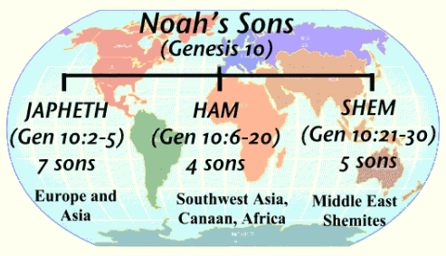
The Bible – Class 2
God gives promises to Abraham: Genesis 12
Abraham prays for a city: Genesis 18
Zondervan,. NIV, Kids' Visual Study Bible, Full Color Interior: Zonderkidz. Kindle Edition.

Slide 20
The Bible – Class 2
God gives promises to Abraham: Genesis 12
Genesis 12: ¹The LORD had said to Abram, “Go from your country, your people and your father’s household to the land I will show you. Abraham’s Faults ²“I will make you into a great nation, and I will bless you; I will make your name great, and you will be a blessing. ³I will bless those who bless you, and whoever curses you I will curse; and all peoples on earth will be blessed through you.” ⁴So Abram went, as the LORD had told him; and Lot went with him. Abram was seventy-five years old when he set out from Harran. ⁵He took his wife Sarai, his nephew Lot, all the possessions they had accumulated and the people they had acquired in Harran, and they set out for the land of Canaan, and they arrived there.
Genesis 17: ¹⁰This is my covenant with you and your descendants after you, the covenant you are to keep: Every male among you shall be circumcised. ¹¹You are to undergo circumcision, and it will be the sign of the covenant between me and you. ¹²For the generations to come every male among you who is eight days old must be circumcised,
Zondervan,. NIV, Kids' Visual Study Bible, Full Color Interior: Zonderkidz. Kindle Edition.

Slide 21
The Bible – Class 2
Abraham prays for a city: Genesis 18
Genesis 18: ²⁰Then the LORD said, “The outcry against Sodom and Gomorrah is so great and their sin so grievous ²¹that I will go down and see if what they have done is as bad as the outcry that has reached me. If not, I will know.” ²²The men turned away and went toward Sodom, but Abraham remained standing before the LORD. ²³Then Abraham approached him and said: “Will you sweep away the righteous with the wicked? ²⁴What if there are fifty righteous people in the city? Will you really sweep it away and not spare the place for the sake of the fifty righteous people in it? ²⁵Far be it from you to do such a thing—to kill the righteous with the wicked, treating the righteous and the wicked alike. Far be it from you! Will not the Judge of all the earth do right?” .. ³²Then he said, “May the Lord not be angry, but let me speak just once more. What if only ten can be found there?” He answered, “For the sake of ten, I will not destroy it.”
Zondervan,. NIV, Kids' Visual Study Bible, Full Color Interior: Zonderkidz. Kindle Edition.

Slide 22
The Bible – Class 2
Jacob steals Esau’s blessing: Genesis 27
Genesis 27: 1– 45 portrays the human actions leading to Jacob’s becoming heir to the covenant. Having already exchanged a bowl of stew in return for Esau’s claim on firstborn status, Jacob follows Rebekah’s advice in deceiving Isaac into blessing him rather than Esau. Once enacted, such a formal blessing was understood to be unalterable. The attitude of the narrative toward Jacob’s deception of Isaac is paradoxical: on the one hand, it is within God’s plan that Jacob should be the heir to the covenant; on the other hand, Jacob will eventually humble himself before Esau, seeking reconciliation (33: 1– 17).
Donald Senior; John Collins; Mary Ann Getty. The Catholic Study Bible (p. 321). Oxford University Press. Kindle Edition.

Slide 23
The Bible – Class 2
Jacob’s name is changed: Genesis 32
A repeated pattern in these stories establishes the special relationship that the Israelites have with the Lord, emphasizing its distinctiveness by comparison to Israel’s neighboring nations. In each of the first three generations, God chooses Israel’s ancestor rather than someone else. For each of the three patriarchs, a counterpart is not chosen, each of whom is associated with a people who play an important role in Israel’s subsequent story. Abraham has a nephew, Lot, who fathers both the Ammonites and the Moabites. Jacob has a brother, Esau, who fathers the Edomites. The Ammonites, Moabites, and Edomites were nations residing East of the Jordan and were often in conflict with the Israelites.
Donald Senior; John Collins; Mary Ann Getty. The Catholic Study Bible (pp. 311-312). Oxford University Press. Kindle Edition.

Slide 24
The Bible – Class 2
Jacob’s name is changed: Genesis 32
Isaac has a half-brother Ishmael, son of the Egyptian Hagar. From the name Ishmael comes the term Ishmaelite, which refers broadly to bedouin or desert Arabs. A group of Ishmaelites bring Joseph to Egypt after he is sold to them by his brothers.
While these narratives demonstrate God’s solicitude for Abraham and his heir Israel, it is beginning in Exodus that the relationship is described explicitly as familial: Israel is God’s son (Ex 4: 22– 23). Moses’s speeches in Deuteronomy expand on God’s parental commitment to love Israel.
Donald Senior; John Collins; Mary Ann Getty. The Catholic Study Bible (p. 312, 313). Oxford University Press. Kindle Edition.

Slide 25
The Bible – Class 2
Joseph’s brothers sell him into slavery: Genesis 37
The account of Joseph’s sale into slavery by his brothers sets the stage for the remainder of the book. The family loyalty demonstrated by the brothers’ indignation over the violation of Dinah dissipates under the weight of their envy over Jacob’s preference for Joseph. For his part, the immature Joseph does not grasp how his brothers would be incited by his favored status, his giving bad reports to their father about them, and his describing of dreams that suggest his superiority. The full significance of his dreams will not become clear until Joseph and his brothers have gained wisdom from their struggles.
Donald Senior; John Collins; Mary Ann Getty. The Catholic Study Bible (p. 325). Oxford University Press. Kindle Edition. .

Slide 26
The Bible – Class 2
Joseph becomes a ruler: Genesis 39-41
The Lord’s covenant blessing and the protection promised to Jacob has extended to Joseph, and because of him Potiphar’s household flourishes. Joseph is “well-built and handsome” (39: 6), which was understood as a sign of divine favor. But when his appearance attracts the attention of his master’s wife, his character is tested by her adulterous proposition. He refuses, citing the loyalty he owes his master. Yet, because of the wife’s false accusations against him, Joseph is thrown in jail.
Upon hearing Joseph’s interpretations, Pharaoh recognizes that Joseph is endowed with the spirit of God and places him in charge of his household to prepare for the great famine portended by his dreams.
Donald Senior; John Collins; Mary Ann Getty. The Catholic Study Bible (pp. 327-328). Oxford University Press. Kindle Edition.

Slide 27
The Bible – Class 2
Joseph becomes a ruler: Genesis 39-41
Despite Joseph’s personal success in Pharaoh’s service, within the larger story the situation verges on catastrophic, for the beloved son of Jacob seems at risk to abandon his family identity by becoming an Egyptian. He receives an Egyptian name, Zaphenath-paneah. Conflicting with the explicit commands of Abraham and Isaac that their sons marry within their own people, Joseph takes an Egyptian wife, Asenath, by whom he has two sons: first Manasseh, and then Ephraim.
Donald Senior; John Collins; Mary Ann Getty. The Catholic Study Bible (p. 331). Oxford University Press. Kindle Edition.

Slide 28
The Bible – Class 2
Joseph becomes a ruler: Genesis 39-41
Concerning the question of which of Leah’s first four sons will be accorded firstborn status, the content of the poetry reflects the narrative. Based on both the length and content of the passages, it is clear that Judah and Joseph are accorded firstborn status, as is reflected in Israelite history. In Israelite history, the Southern Kingdom is known as Judah, and the Northern Kingdom can be referred to as Ephraim or Joseph, as well as Israel.
Donald Senior; John Collins; Mary Ann Getty. The Catholic Study Bible (p. 331). Oxford University Press. Kindle Edition.

